Slide 1
EERA Joint Programme on Energy Storage Award Salvatore Vasta (CNR), JP ES SP3 Coordinator
Myriam E. Gil Bardají (KIT), JP ES Manager
Olga Suminska-Ebersoldt (KIT-HIU), JP ES Manager

Slide 2
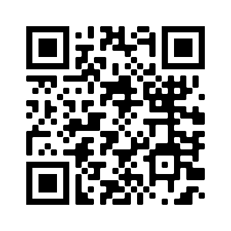
JP ES OVERVIEW
Numbers and Figures
Established in 2011
40 ROs and Universities dedicated to low-carbon technology research
14 Member States /Associated countries collaborating through JP ES

Slide 3
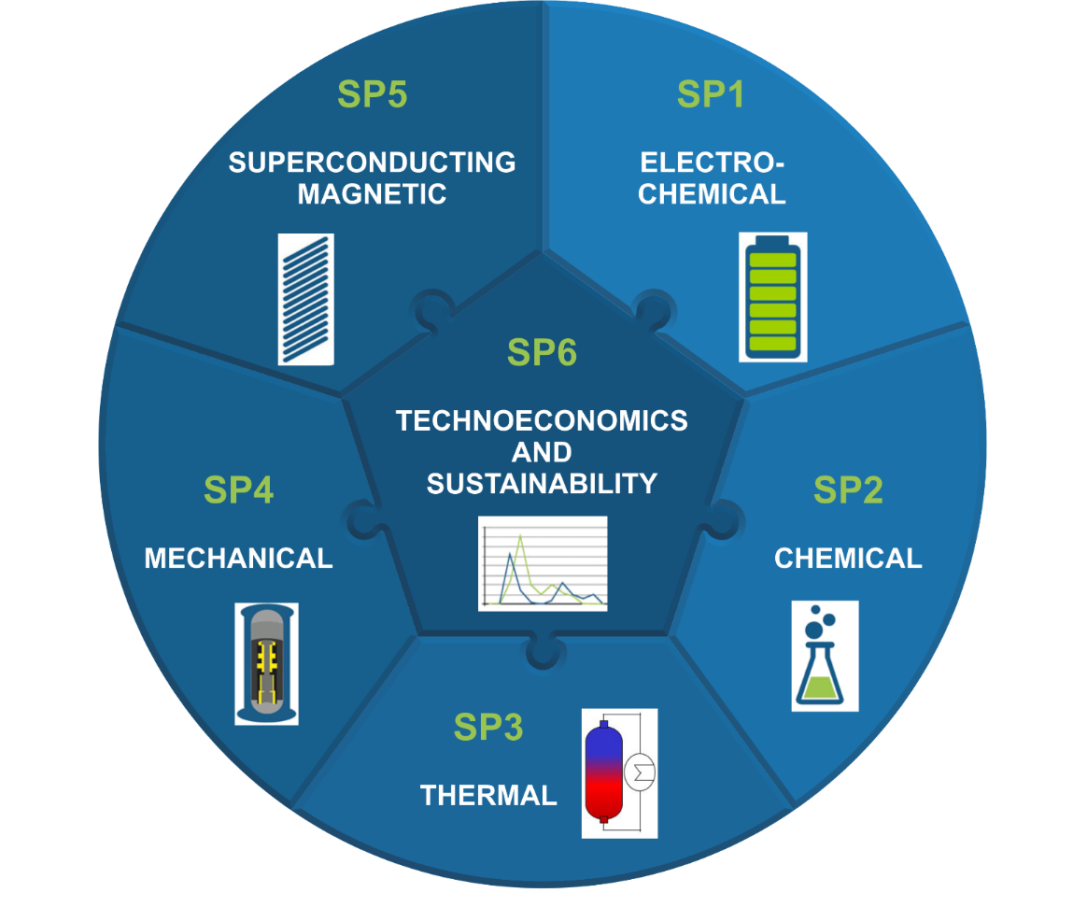
JP ES OVERVIEW
Mission and Vision
The JP ES addresses medium to long-term research perspectives on energy storage (SET-Plan) and aims at:
developing common research and coordinating the scientific community
establishing a dialogue at European level among all stakeholders involved in energy storage R&D
facilitating knowledge transfer by communication with industry and stakeholders
advising policy makers by identification of regulatory barriers and providing policy recommendations
establishing best practices by developing new technologies and pave the way to market introduction

Slide 4
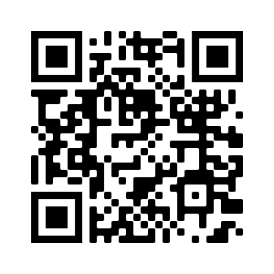
establishing a dialogue at European level among all stakeholders involved in energy storage R&D
Key research priority: Hybridisation of Energy Storage
combining energy storage technologies to address different energy requirements (hours, days, months, seasonal…)
Storage Research Infrastructure Eco-System in Europe with a focus on
improving materials for devices
optimizing hybrid energy systems to make energy technologies more competitive and cost-efficient
analysing of socio-technical and environmental aspects of new developments and systems
providing training and education
16 full participants
31 beneficiaries
64 research infrastructures
17 countries
80 external supporters
click here

Slide 5
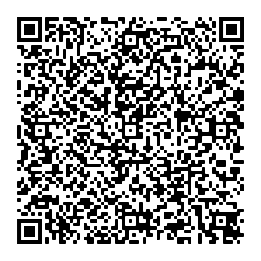
developing common research and coordinating the scientific community
facilitating knowledge transfer by communication with industry and stakeholders
Dr. Eng. Salvatore Vasta, PhD.
Research Engineer
Head of Thermally Driven Heat Pumps and Thermal Storage Research Group
Coordinator of the EERA Sub-Program on Thermal Energy Storage
Consiglio Nazionale delle Ricerche (CNR)
Istituto di Tecnologie Avanzate per l'Energia "Nicola Giordano" (ITAE)
Via Salita S. Lucia sopra Contesse n. 5
98126, Messina, ITALY
P: +39.090.624.404 – M: +39.338.212.4147 - F: +39.090.624.247
Skype: salvo-vasta
W: www.itae.cnr.it - E: salvatore.vasta@itae.cnr.it

Slide 6
JP ES Award at ENERSTOCK 2021
intended for excellent PhD students and researchers within two years after completion of the PhD degree
1st Prize of 300€ (best oral)
Kai Knobloch
Technical University of Denmark, Lyngby, Denmark
Vertical rock bed for high temperature energy storage: pilot plant findings
2nd Prize of 200€ (best short oral - poster)
Karin Edel
Czech Technical University in Prague, Czech Republic
Speed of reaching the full potential heat capacity of a basalt product: mathematical model based on experimental results

